Slide 1

Weather Check- Canada
Team -10
Sambulo Malumisa, Sunday Akiyesi, Yalda Alemi And Deepika Mehanti

Slide 2
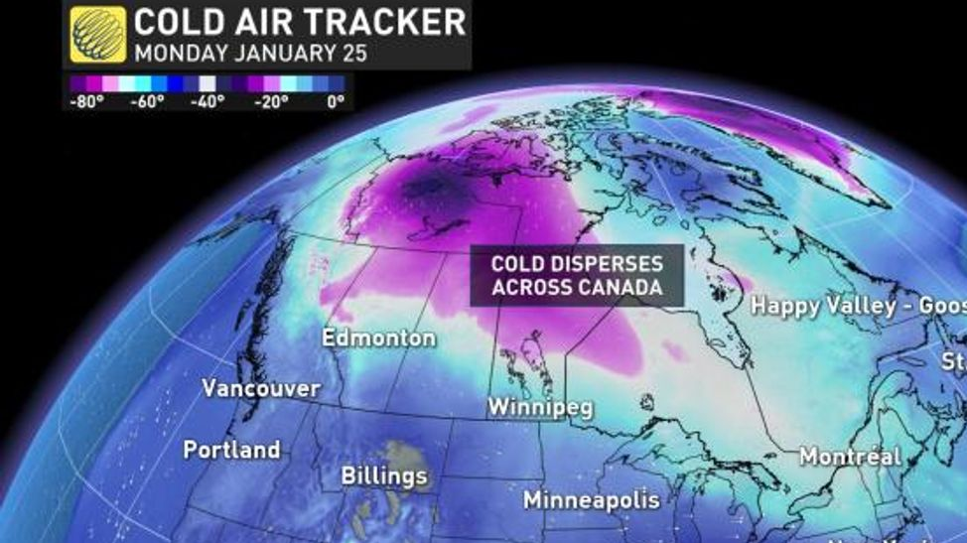
What are we observing with Canada Climate check ? 1. Different cities with different temperature. 2. How the latitude is affecting Pressure in different cities. 3. Temperature Forecast of different cities. 4. Maps showing the cities featuring different factors like temperature, Humidity ,pressure etc.

Slide 3
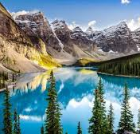

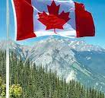
Data Sources
1. https://api.weather.gc.ca/
2. https://worldpopulationreview.com/countries/cities/canada
3. https://api.weather.gc.ca/openapi?f=html3
4. https://www.canada.ca/en/environment-climate-change/services/weather-general-tools-resources/how-we-use-observation-site/understanding-current-conditions-on-website.html
5. https://en.wikipedia.org/wiki/Temperature_in_Canada
6. https://www.kaggle.com/datasets/hemil26/canada-weather

Slide 4
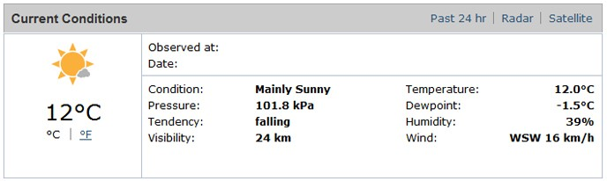
Understanding current weather conditions
Temperature
Dewpoint
Humidity
Air Pressure
Pressure Tendency
Visibility
Wind
Air Quality
Wind Chill
Humidex

Slide 5
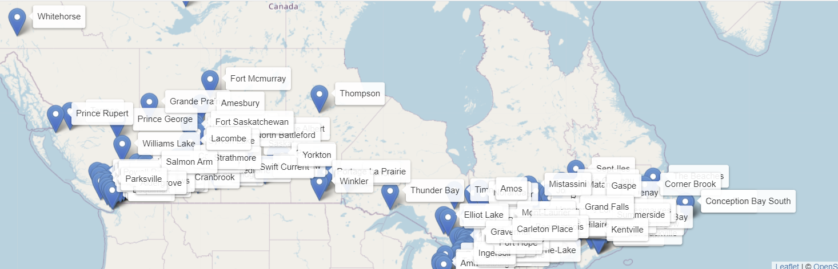
Canada Map showing dropdown menu with : 1. Temperature in Celsius 2. Temperature in Fahrenheit 3. Feels like 4. Humidity 5. Precipitation 6. Pressure 7.Wind
file:///C:/Users/deepi/OneDrive/Desktop/Challange_files/Project_3_team_10/project%203%20me/index.html

Slide 8
Thank You!
Questions ?

